Slide 1
Group demographics

Slide 2
Group demographics pareggiato
 | ADMCI (n = 14) | Nold (n=14) | p
Age | 65,3 | 61,6 | 0,11
Education | 14,14 | 14,42 | 0.86
Gender (F:M) | 8:6 | 7:7 | ns

Slide 3
Withdrawal
No progress to dementia
Progress to dementia (AD+LBD)
Progress to dementia (AD)
Brescia01 | Brescia14 | Brescia15 | Brescia16 | Brescia17 | Brescia19 | Brescia20 | Brescia23 | Brescia26 | Brescia32 | Brescia33
T24 | T24 | T24 | T06 | T24 | T12 | T18 | T24 | T24 | T12 | T18
Progress to dementia (AD) | No progress to dementia | No progress to dementia | No progress to dementia | No progress to dementia | Progress to dementia (AD) | Progress to dementia (AD) | Progress to dementia (AD) | Progress to dementia (AD+LBD) | No progress to dementia | No progress to dementia
Genova01 | Genova02 | Genova03 | Genova04 | Genova05 | Genova06 | Genova08 | Genova09 | Genova17
T36 | T36 | T06 | T36 | T30 | T12 | T18 | T30 | T24
No progress to dementia | No progress to dementia | No progress to dementia | No progress to dementia | No progress to dementia | Progress to dementia (AD) | Withdrawal | No progress to dementia | No progress to dementia
Leipzig01 | Leipzig04 | Lille04 | Marseille01 | Marseille05 | Marseille06 | Marseille07 | Marseille11 | Thessaloniki17 | Thessaloniki26 | Toulouse04 | Toulouse05
T12 | T24 | T24 | T36 | T24 | T24 | T24 | T24 | T24 | T24 | T24 | T24
Progress to dementia (AD) | No progress to dementia | No progress to dementia | No progress to dementia | No progress to dementia | No progress to dementia | No progress to dementia | No progress to dementia | No progress to dementia | No progress to dementia | No progress to dementia | Progress to dementia (AD)

Slide 4
Small group demographics for preliminary evaluation
 | ADMCI-Sleep (n = 6 ) | ADMCI – NO Sleep (n = 5 ) | Nold (n = 5 ) | p
Age | 70.4 | 69.2 | 69.8 | ns
Education | 15.2 | 15.6 | 15.4 | ns
Gender (F:M) | 3:3 | 2:3 | 2:3 | ns
Abeta/tau | 5.88 | 7.61 | na | ns
MMSE grezzo | 27.5 | 25.8 | na | ns
Soggetti ADMCI -Sleep
Soggetti ADMCI – NO Sleep
Nold
Brescia 01
Brescia 17
Genova 09
Marseille 01
Marseille 17
Thessaloniki 17
Brescia 20
Brescia 23
Brescia 26
Genova 02
Lille 04
Nold 1
Nold 3
Nold 4
Nold 5
Nold 6
- n 6
- n 5
- n 5

Slide 5
Progress
SBJ | T00 | T06 | T12 | Last analysis performed | Diagnosis
Brescia 01 | - | - | - | T24 | Progress to dementia (AD)
Brescia 17 | react | Not react | Not react | T24 | No progress to dementia
Brescia 20 | react | Not react | Not react | T18 | Progress to dementia (AD)
Brescia 23 | react | react | react | T24 | Progress to dementia (AD)
Brescia 26 | react | Not react | Not react | T24 | Progress to dementia (AD+LBD)
Genova 02 | react | Not react | Not react | T36 | No progress to dementia
Genova 09 | Not react | Not react | Not react | T30 | No progress to dementia
Lille 04 | react | react | Not react | T24 | No progress to dementia
Marseille 01 | - | - | - | T36 | No progress to dementia
Marseille 11 | - | - | - | T24 | No progress to dementia
Thessaloniki 17 | react | react | Not react | T24 | No progress to dementia

Slide 6
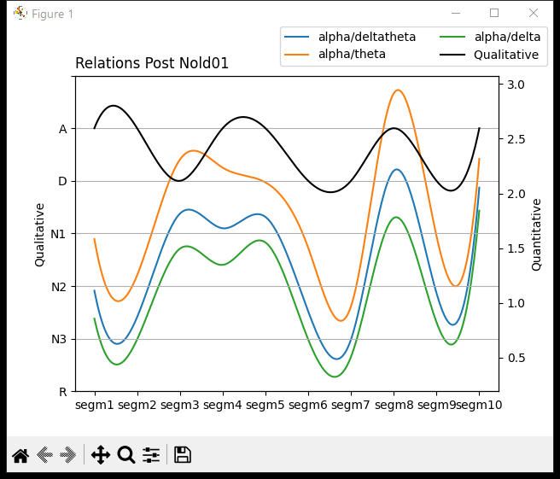
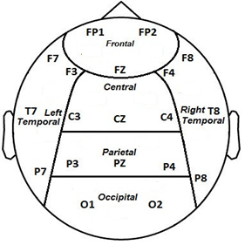
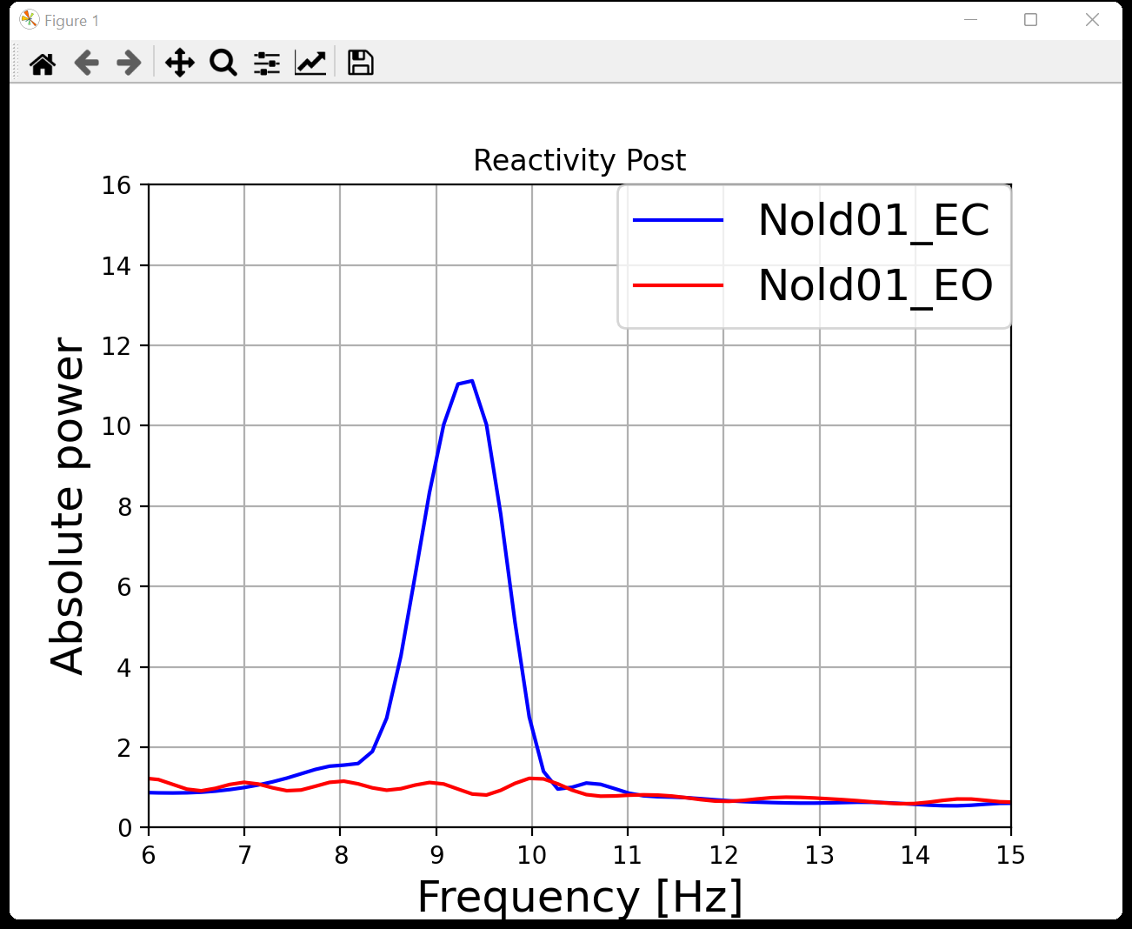
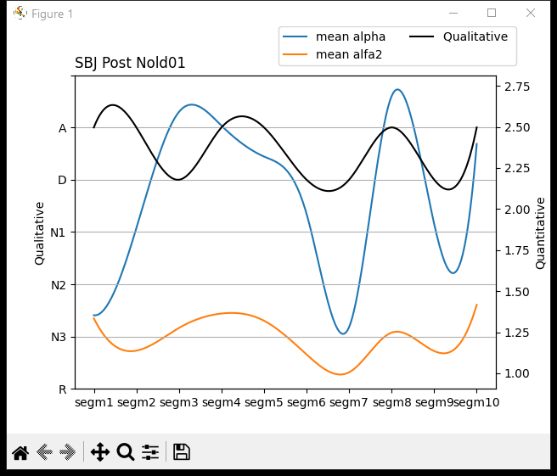
Nold01
CPO
TF | IAF
5,5 | 8,5
5,5 | 10
6,5 | 10
6 | 10
6,5 | 9,5
5,5 | 9,5
5,5 | 9,5
6,5 | 10
5,5 | 9,5
6,5 | 9,5
6 | 10
This graph represents the reactivity of the Nold01 subject taking the recording of the signal in the resting state.

Slide 7
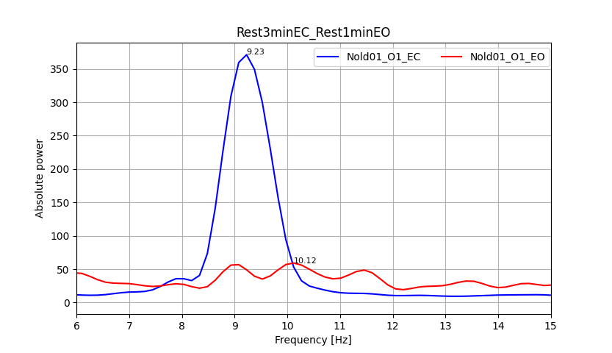
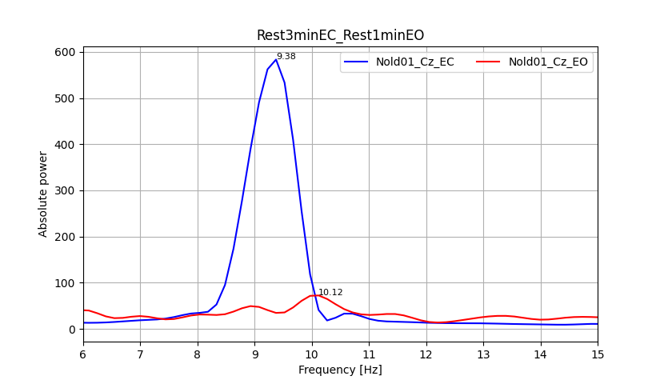
Nold01
This graph represents the channel with best reactivity of the Nold01 subject taking the signal recording in the resting state for eyes open and the signal recording in the resting state for eyes closed.

Slide 8
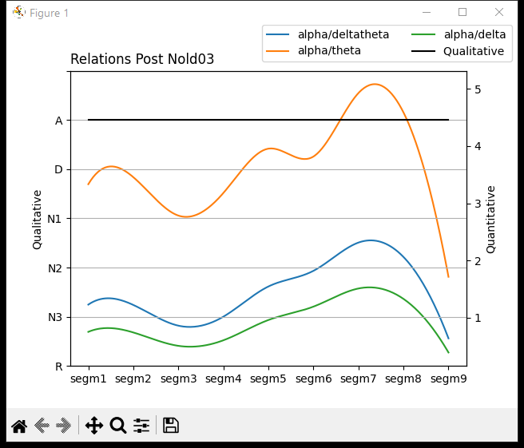
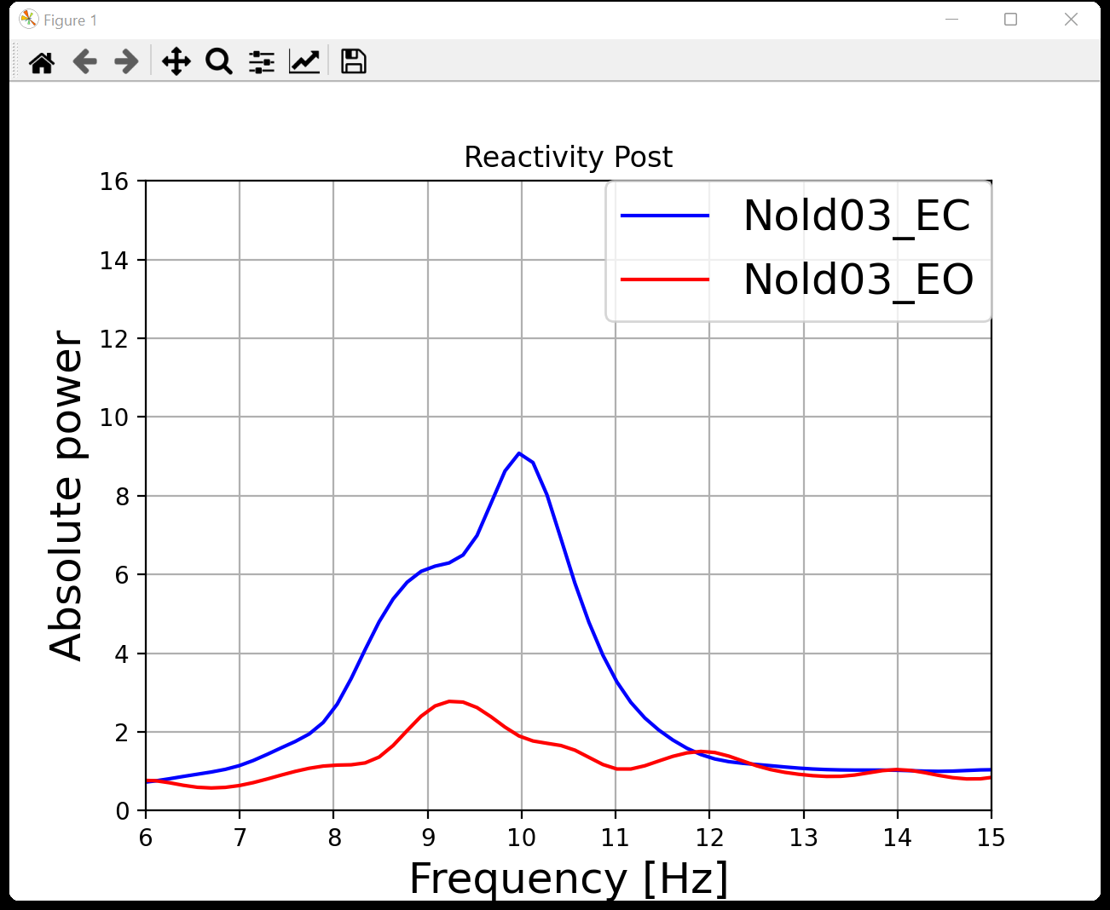
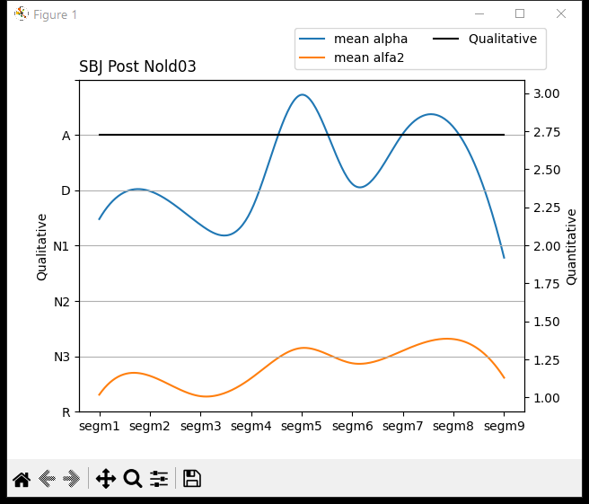
Nold03
CPO
TF | IAF
5 | 10
5 | 10,5
4,5 | 10
5 | 10
5 | 10,5
5,5 | 10
5,5 | 10
5,5 | 10
4 | 10
5 | 10
This graph represents the reactivity of the Nold03 subject taking the recording of the signal in the resting state.

Slide 9
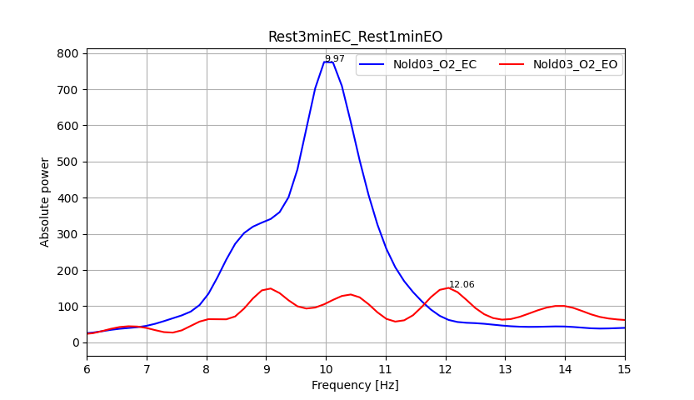
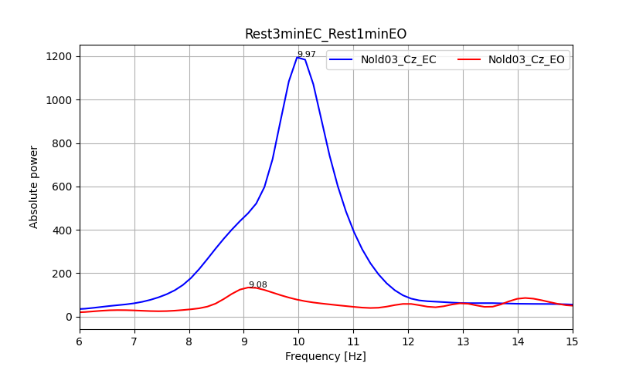
Nold03
This graph represents the channel with best reactivity of the Nold03 subject taking the signal recording in the resting state for eyes open and the signal recording in the resting state for eyes closed.

Slide 10
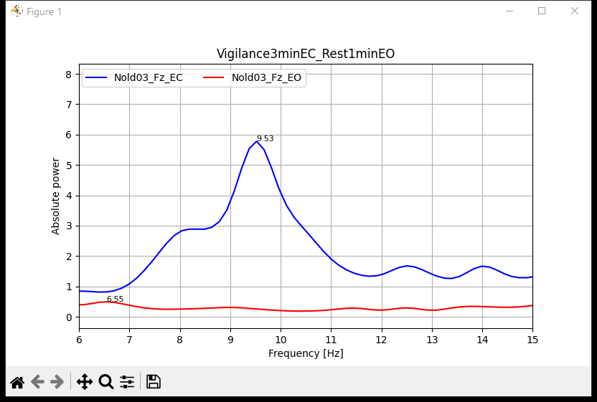
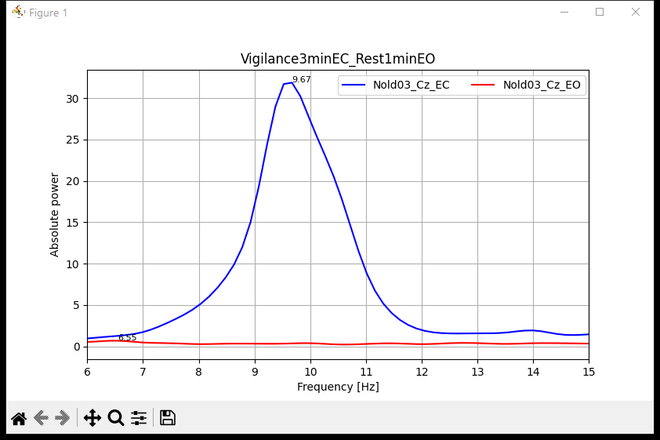
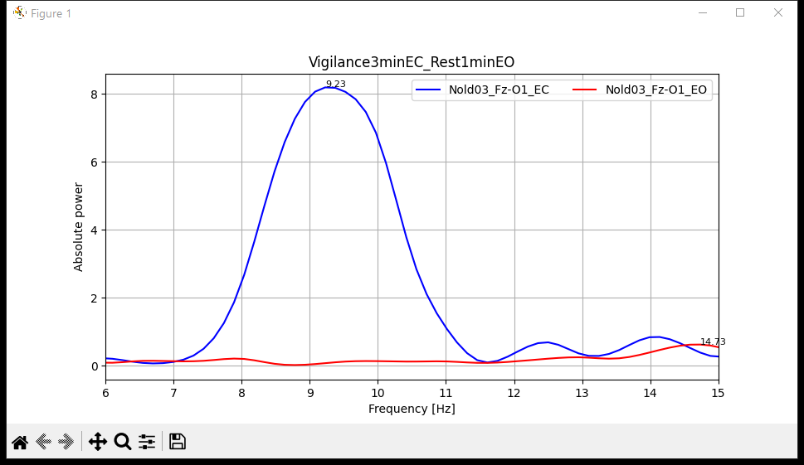
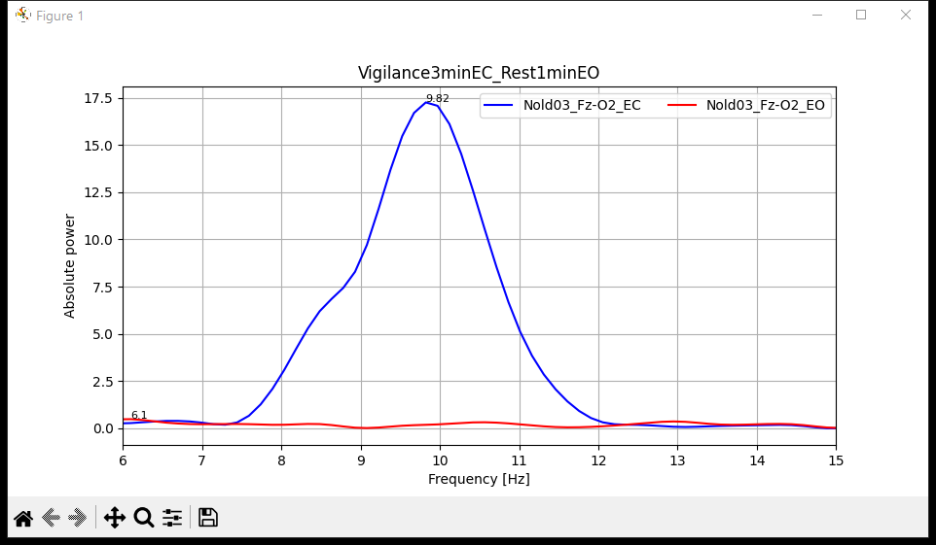
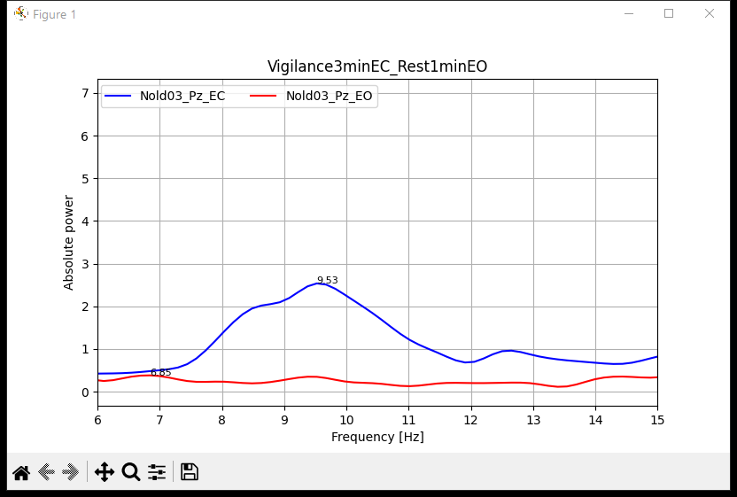
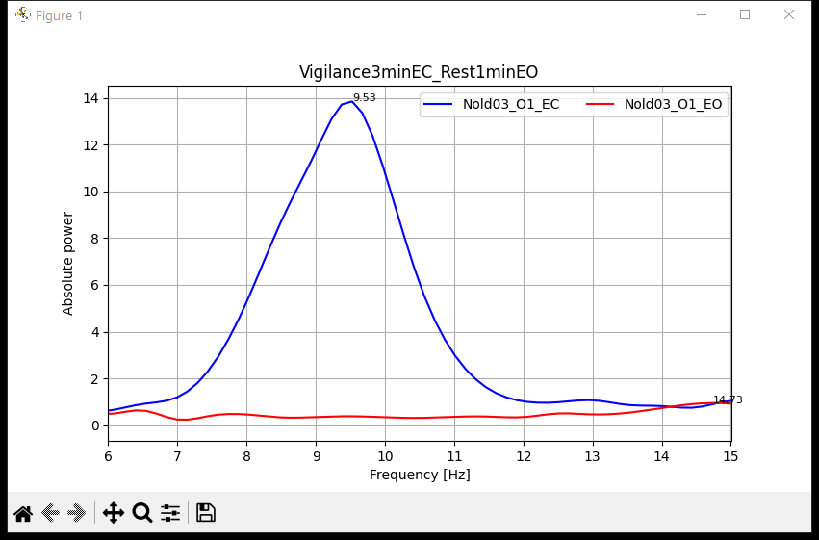
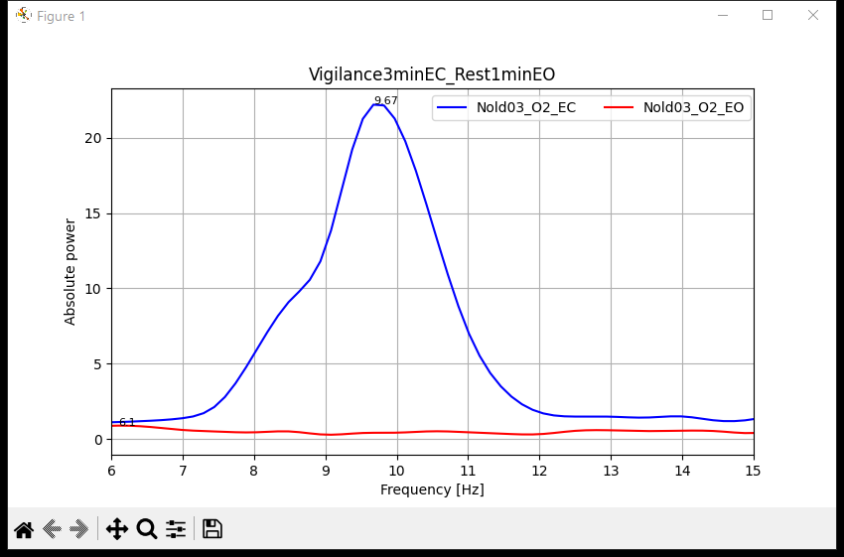
Nold03
This graph represents the reactivity of the Nold03 subject taking the signal recording in the resting state for eyes open and the signal recording in the vigilance task for eyes closed.

Slide 11
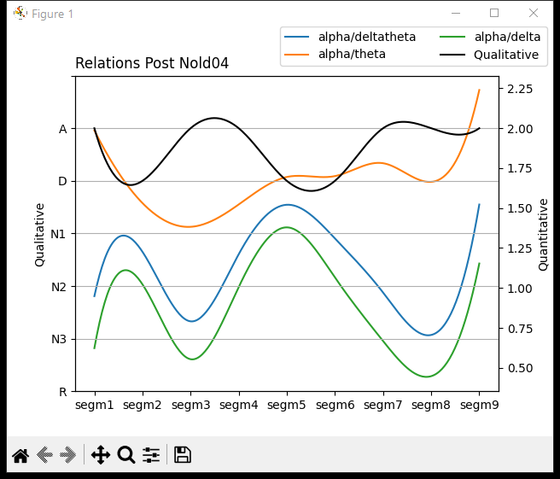
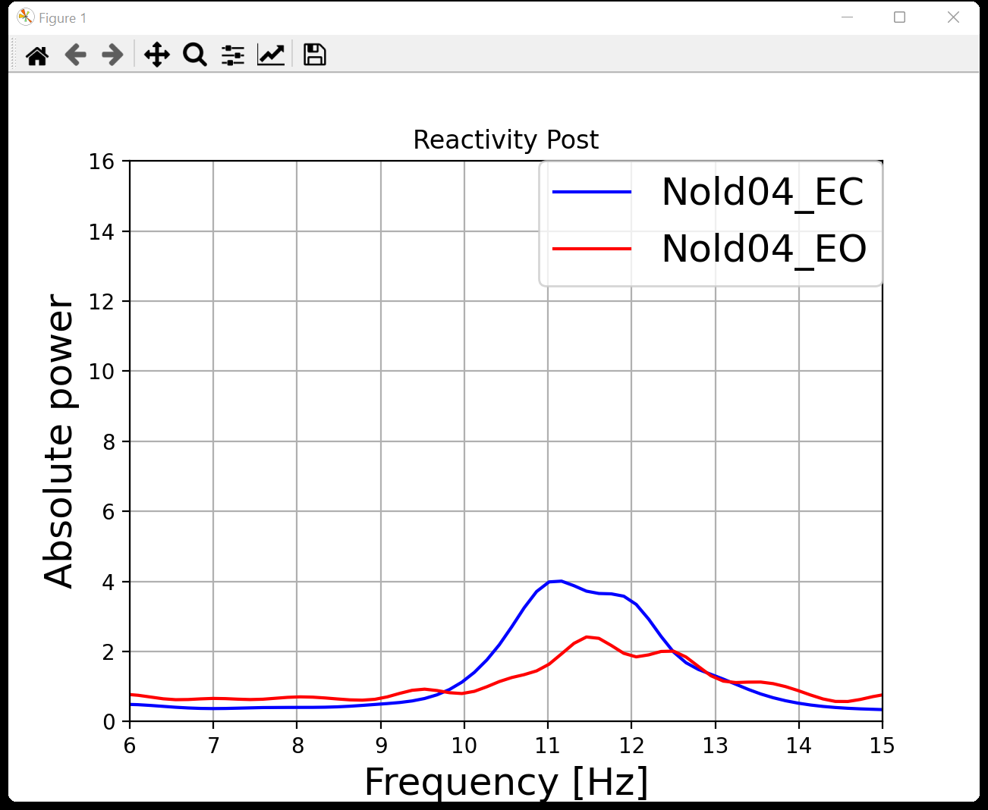
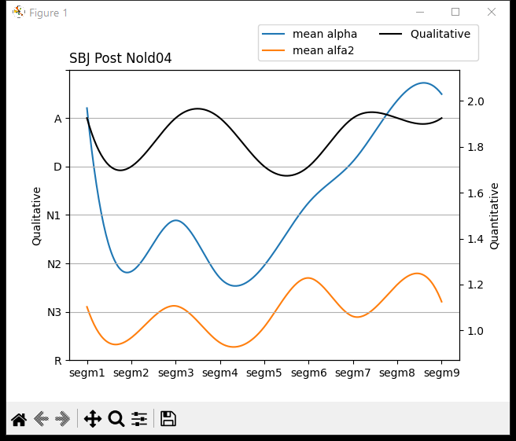
Nold04
CPO
TF | IAF
5,5 | 11,5
6,5 | 11,5
5,5 | 12
6,5 | 11,5
7,5 | 11,5
6,5 | 11,5
5,5 | 11,5
5 | 11
6 | 11,5
7 | 11
This graph represents the reactivity of the Nold04 subject taking the recording of the signal in the resting state.

Slide 12
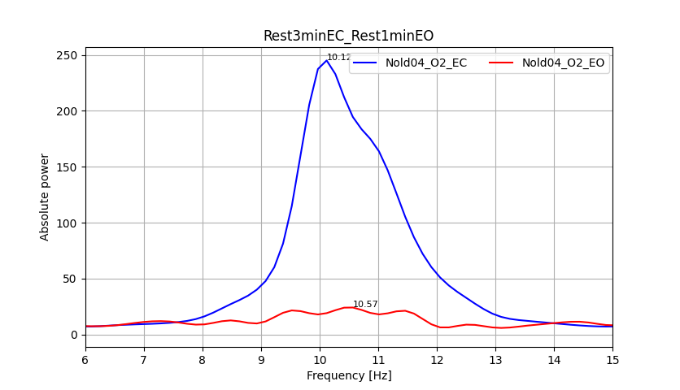
Nold04
This graph represents the channel with best reactivity of the Nold04 subject taking the signal recording in the resting state for eyes open and the signal recording in the resting state for eyes closed.

Slide 13
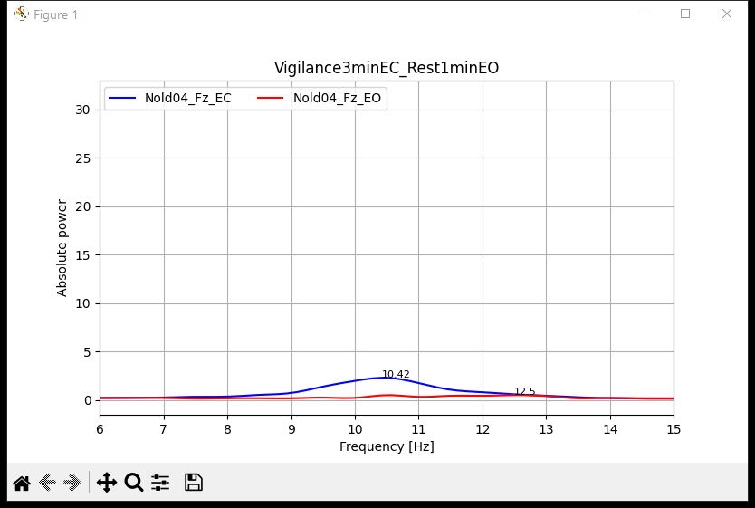
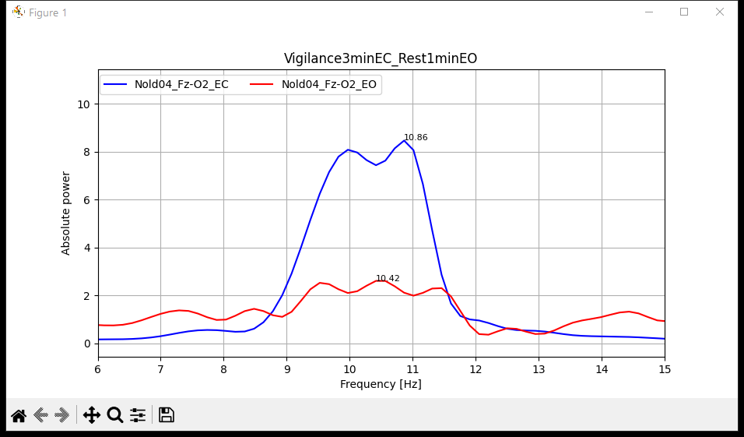
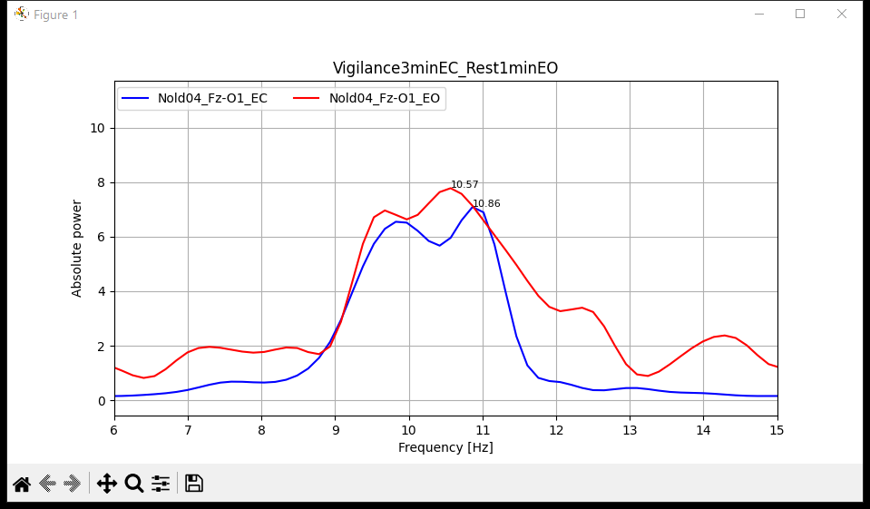
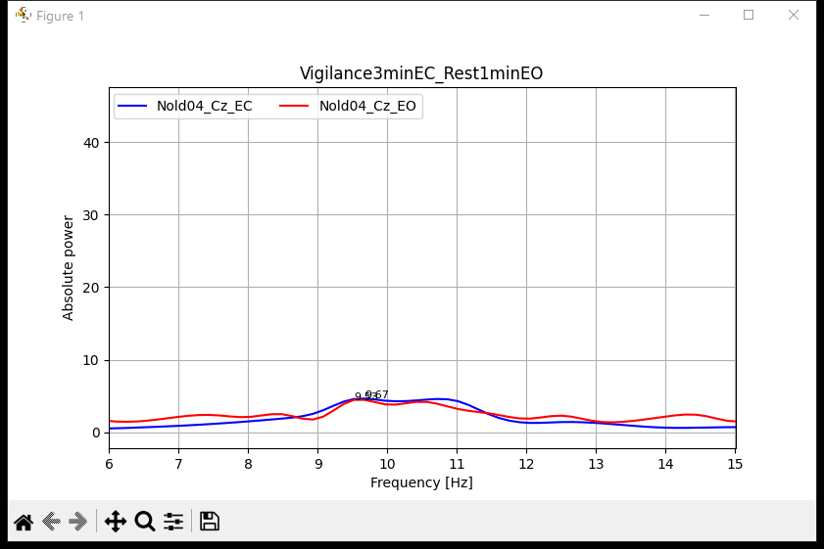
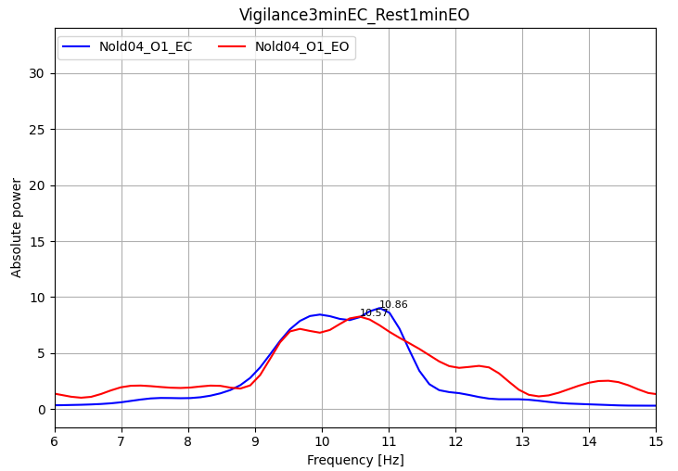
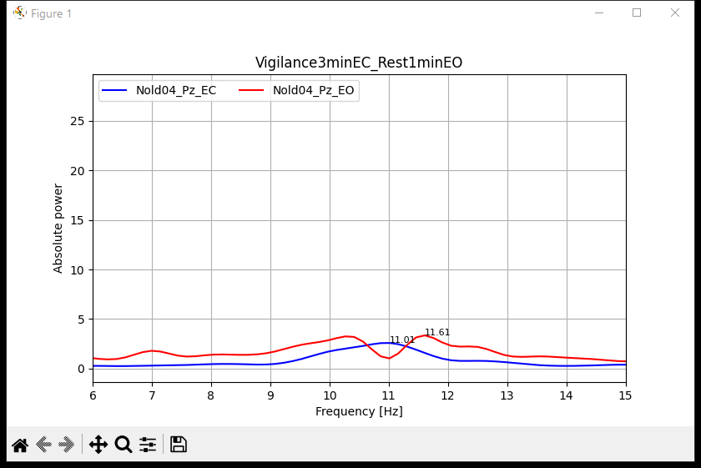
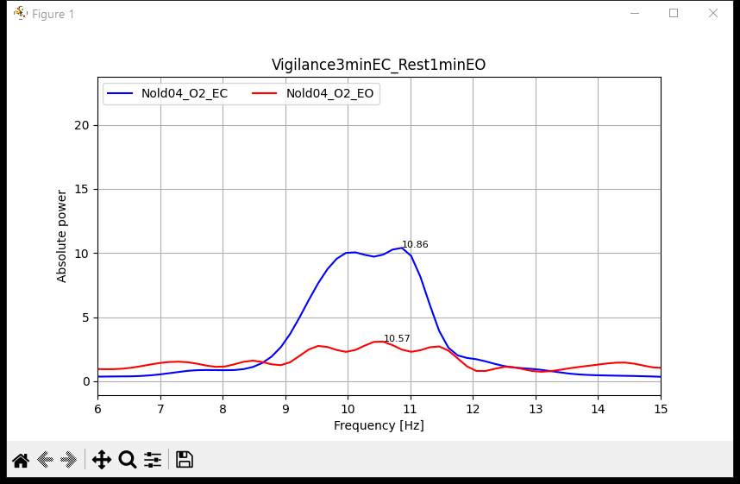
Nold04
This graph represents the reactivity of the Nold04 subject taking the signal recording in the resting state for eyes open and the signal recording in the vigilance task for eyes closed.

Slide 14
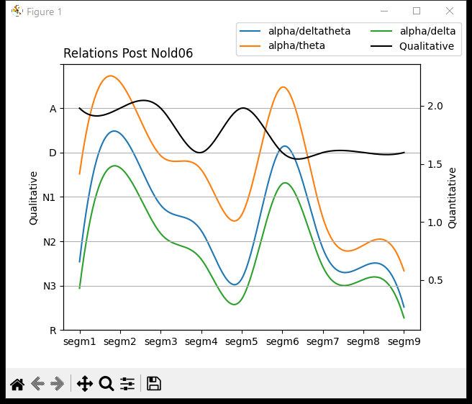
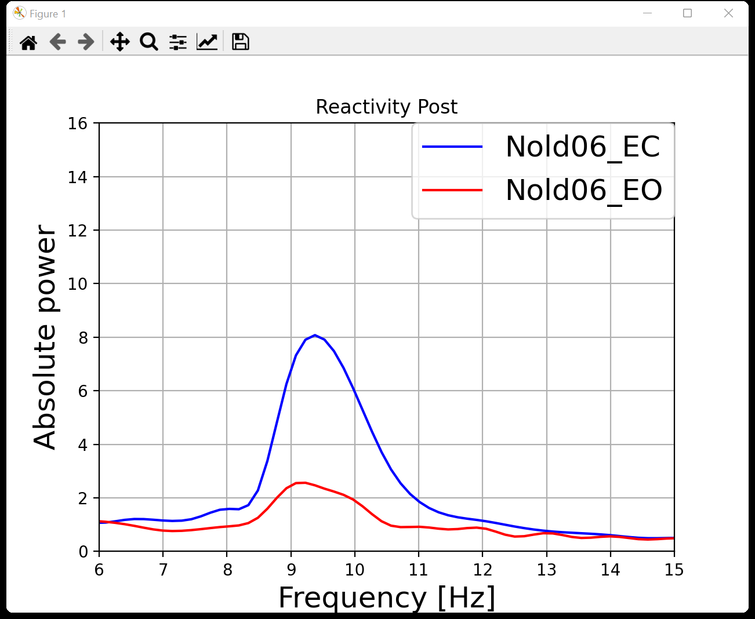
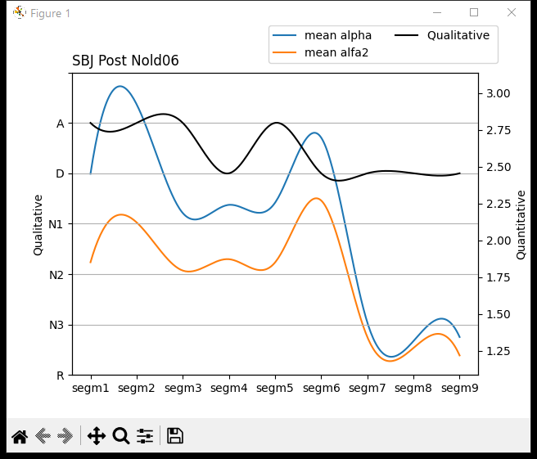
Nold06
CPO
TF | IAF
5 | 9
6,5 | 9
6 | 8,5
5,5 | 9
4,5 | 9
6,5 | 9
6,5 | 9
6,5 | 9
5 | 9
4,5 | 8,5
This graph represents the reactivity of the Nold06 subject taking the recording of the signal in the resting state.

Slide 15
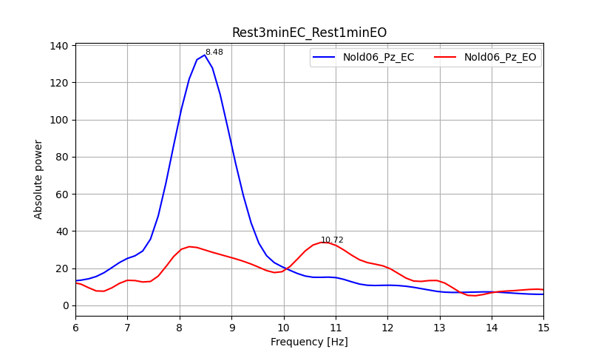
Nold06
This graph represents the channel with best reactivity of the Nold06 subject taking the signal recording in the resting state for eyes open and the signal recording in the resting state for eyes closed.

Slide 16
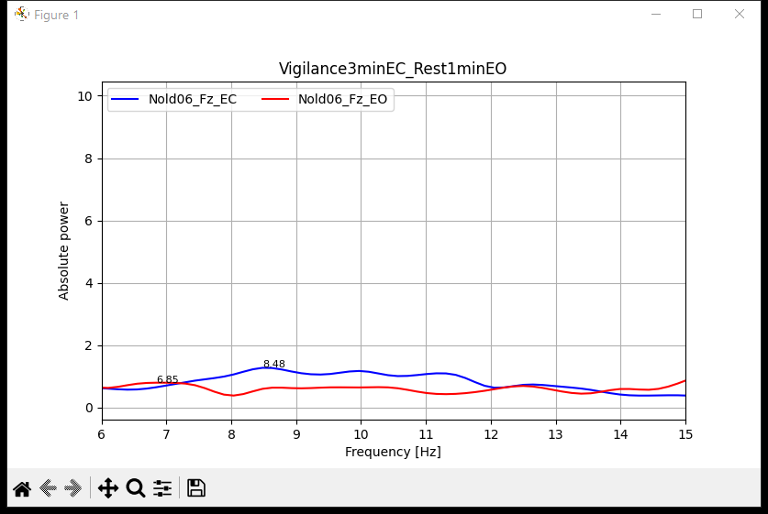
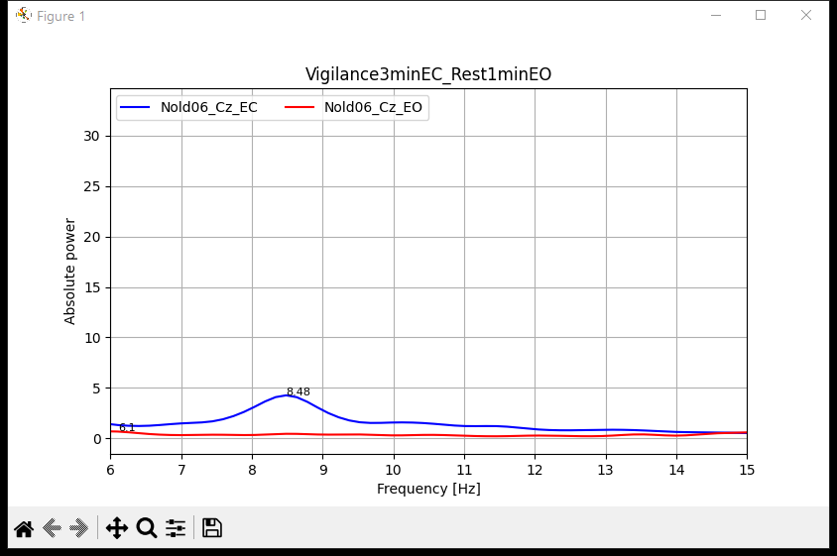
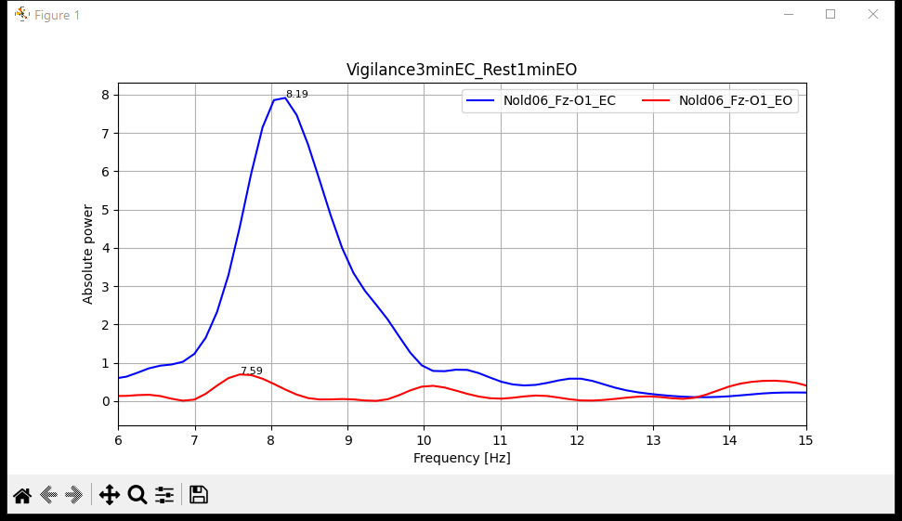
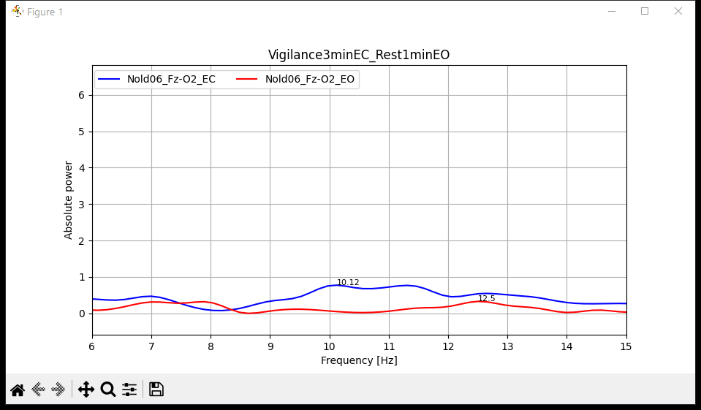
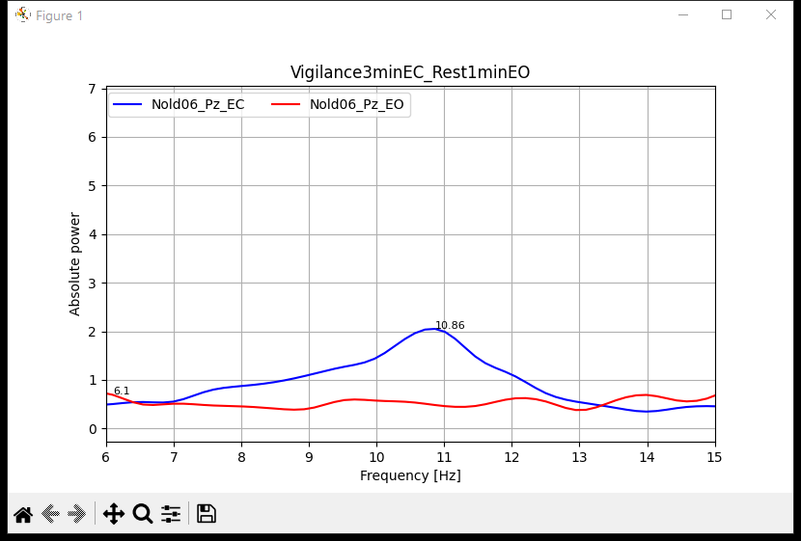
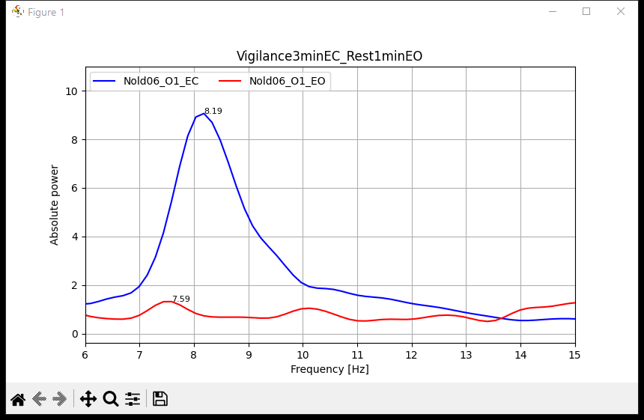
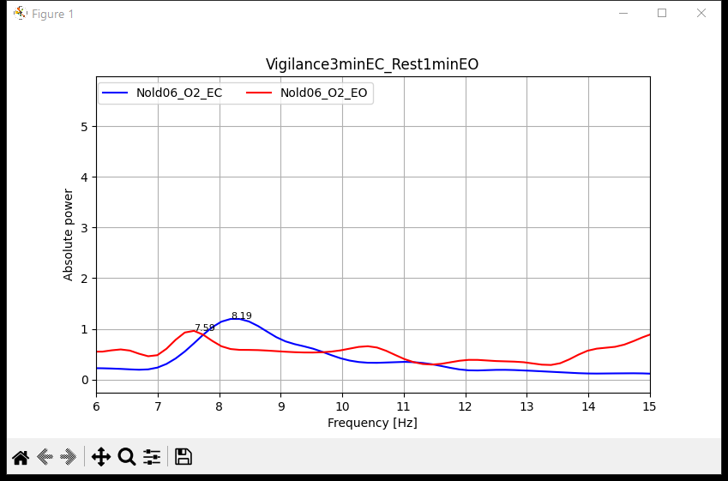
Nold06
This graph represents the reactivity of the Nold06 subject taking the signal recording in the resting state for eyes open and the signal recording in the vigilance task for eyes closed.

Slide 17
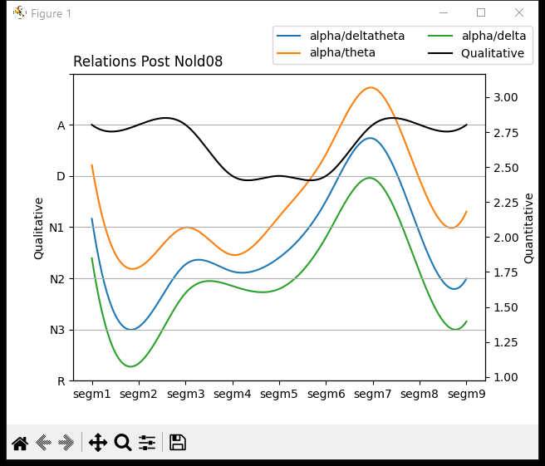
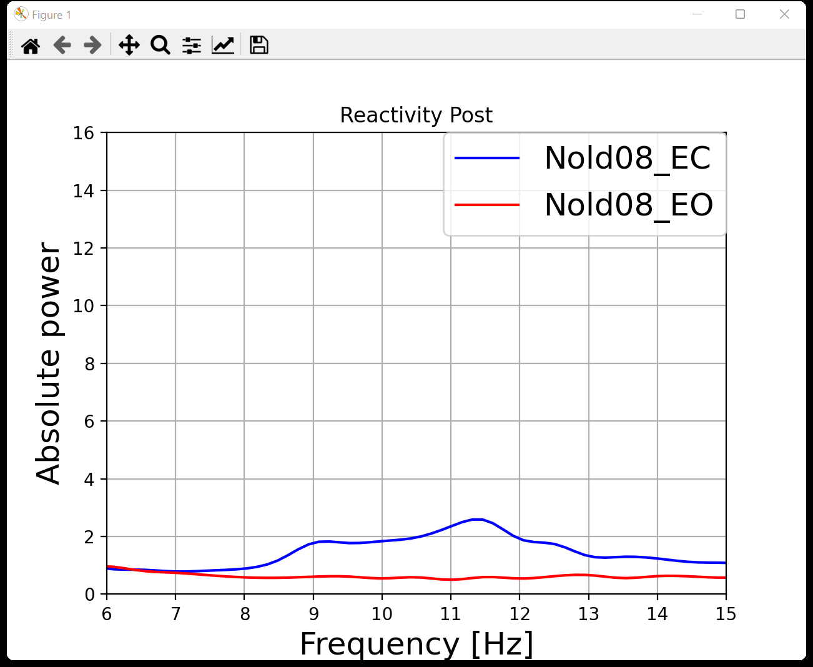
Nold08
CPO
TF | IAF
7 | 10
5,5 | 10,5
7 | 10,5
7,5 | 11,5
7 | 11
7 | 11
7,5 | 11
7,5 | 11
6,5 | 11
7 | 11
This graph represents the reactivity of the Nold08 subject taking the recording of the signal in the resting state.

Slide 18
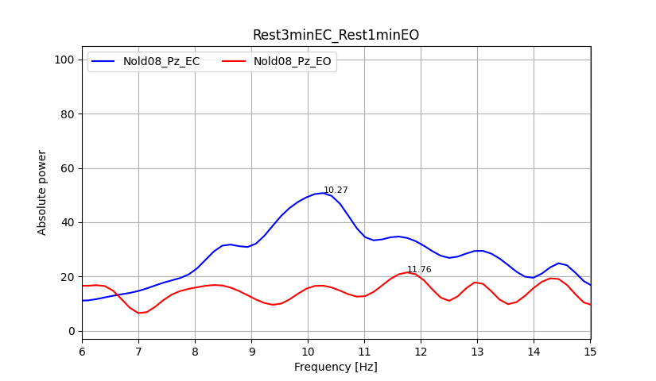
Nold08
This graph represents the channel with best reactivity of the Nold08 subject taking the signal recording in the resting state for eyes open and the signal recording in the resting state for eyes closed.

Slide 19
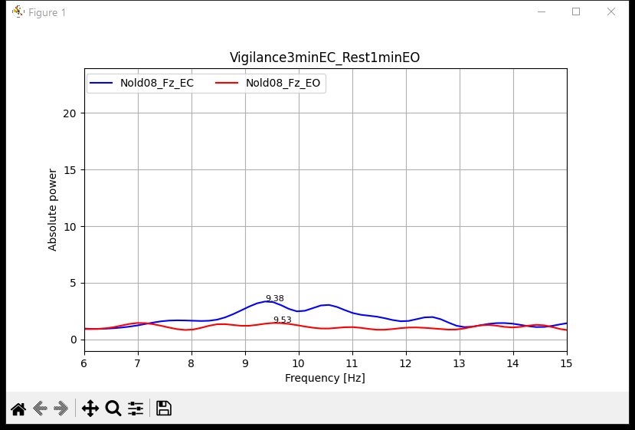
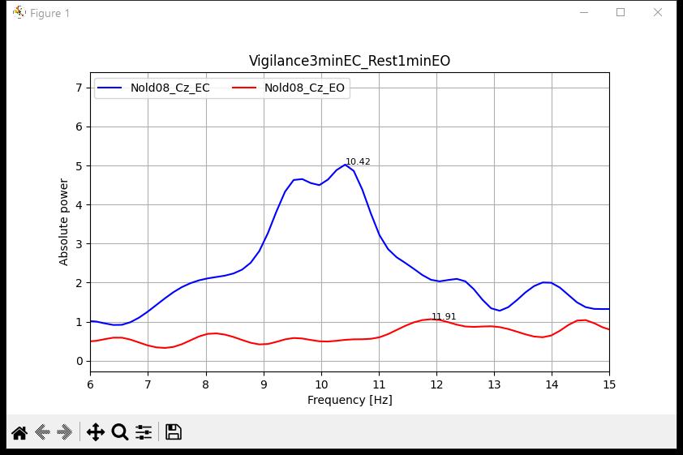
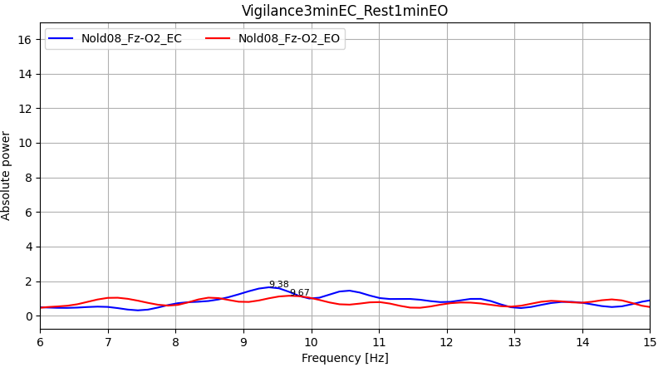
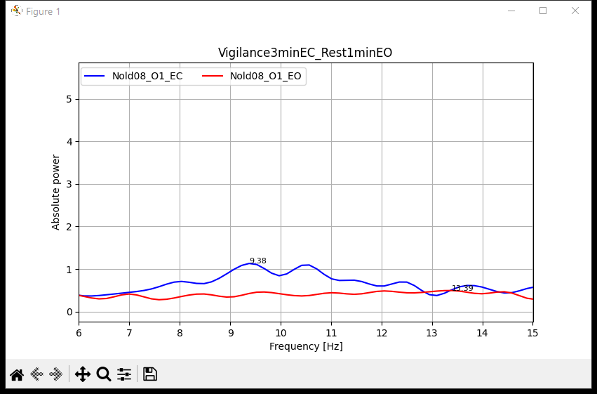
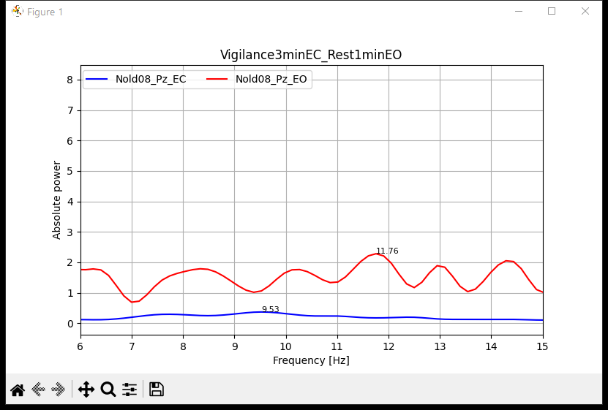
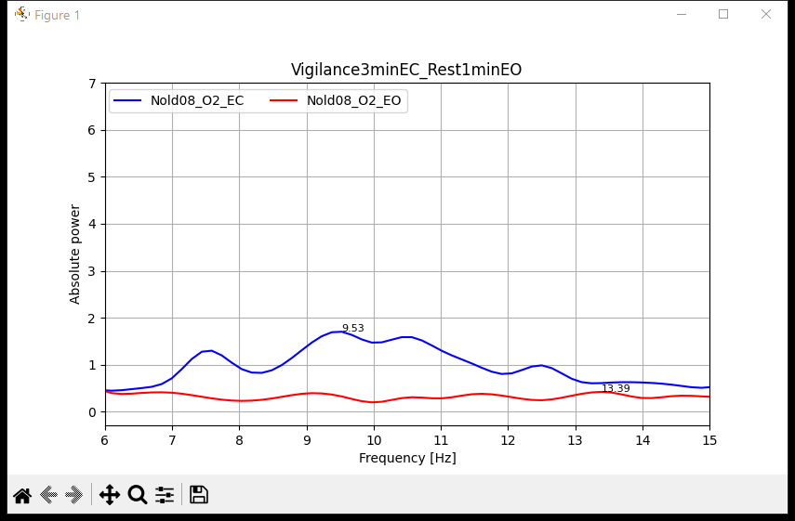
Nold08
This graph represents the reactivity of the Nold08 subject taking the signal recording in the resting state for eyes open and the signal recording in the vigilance task for eyes closed.

Slide 20
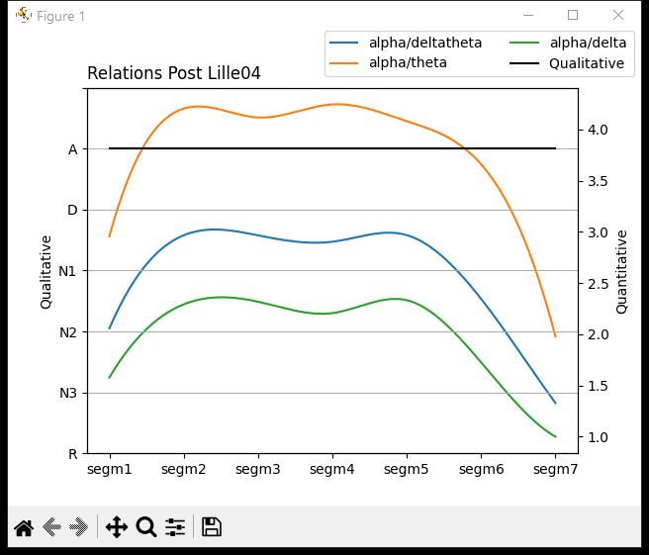


Lille04
CPO
TF | IAF
5 | 9,5
5 | 9,5
5 | 9
5 | 9,5
5 | 9,5
5 | 9,5
5 | 8,5
7,5 | 8,5
This graph represents the reactivity of the Lille04 subject taking the recording of the signal in the resting state.

Slide 21

Lille04
This graph represents the channel with best reactivity of the Lille04 subject taking the signal recording in the resting state for eyes open and the signal recording in the resting state for eyes closed.

Slide 22







Lille04
This graph represents the reactivity of the Lille04 subject taking the signal recording in the resting state for eyes open and the signal recording in the vigilance task for eyes closed.

Slide 23



Thessaloniki17
CPO
TF | IAF
5,5 | 8
6 | 7,5
5,5 | 6,5
5,5 | 6,5
4 | 8
4,5 | 11,5
5,5 | 8,5
This graph represents the reactivity of the Thessaloniki17 subject taking the recording of the signal in the resting state.

Slide 24


Thessaloniki17
This graph represents the channel with best reactivity of the Thessaloniki17 subject taking the signal recording in the resting state for eyes open and the signal recording in the resting state for eyes closed.

Slide 25







Thessaloniki17
This graph represents the reactivity of the Thessaloniki17 subject taking the signal recording in the resting state for eyes open and the signal recording in the vigilance task for eyes closed.

Slide 26



Brescia20
CPO
TF | IAF
5 | 8,5
5,5 | 11
5 | 11,5
5 | 8
6 | 8,5
5 | 7,5
4,5 | 7,5
6 | 7
This graph represents the reactivity of the Brescia20 subject taking the recording of the signal in the resting state.

Slide 27


Brescia20
This graph represents the channel with best reactivity of the Brescia20 subject taking the signal recording in the resting state for eyes open and the signal recording in the resting state for eyes closed.

Slide 28







Brescia20
This graph represents the reactivity of the Brescia20 subject taking the signal recording in the resting state for eyes open and the signal recording in the vigilance task for eyes closed.

Slide 29



Brescia23
CPO
TF | IAF
7 | 9
7 | 10
5,5 | 10,5
5,5 | 10,5
6 | 10,5
6 | 10,5
5,5 | 10,5
7 | 9,5
This graph represents the reactivity of the Brescia23 subject taking the recording of the signal in the resting state.

Slide 30


Brescia23
This graph represents the channel with best reactivity of the Brescia23 subject taking the signal recording in the resting state for eyes open and the signal recording in the resting state for eyes closed.

Slide 31







Brescia23
This graph represents the reactivity of the Brescia23 subject taking the signal recording in the resting state for eyes open and the signal recording in the vigilance task for eyes closed.

Slide 32



Brescia26
CPO
TF | IAF
4 | 8
4 | 7,5
4,5 | 7,5
4 | 7
4 | 8
4 | 7
4 | 7,5
5,5 | 8
This graph represents the reactivity of the Brescia26 subject taking the recording of the signal in the resting state.

Slide 33

Brescia26
This graph represents the channel with best reactivity of the Brescia26 subject taking the signal recording in the resting state for eyes open and the signal recording in the resting state for eyes closed.

Slide 34







Brescia26
This graph represents the reactivity of the Brescia26 subject taking the signal recording in the resting state for eyes open and the signal recording in the vigilance task for eyes closed.

Slide 35



Genova02
CPO
TF | IAF
6,5 | 10
4 | 10
4 | 10
4 | 10
4,5 | 10
5,5 | 10
5,5 | 10
7 | 10
This graph represents the reactivity of the Genova02 subject taking the recording of the signal in the resting state.

Slide 36

Genova02
This graph represents the channel with best reactivity of the Genova02 subject taking the signal recording in the resting state for eyes open and the signal recording in the resting state for eyes closed.

Slide 37


Marseille01
CPO
TF | IAF
8 | 10
5 | 9,5
6,5 | 9
7,5 | 8
5,5 | 8
5,5 | 6,5
7 | 10
4 | 10,5
This graph represents the reactivity of the Marseille01 subject taking the recording of the signal in the resting state.

Slide 38
Marseille01
This graph represents the channel with best reactivity of the Marseille01 subject taking the signal recording in the resting state for eyes open and the signal recording in the resting state for eyes closed.

Slide 39







Marseille01
This graph represents the reactivity of the Marseille01 subject taking the signal recording in the resting state for eyes open and the signal recording in the vigilance task for eyes closed.

Slide 40


Marseille11
CPO
TF | IAF
4,5 | 9,5
4,5 | 7,5
4 | 7
5 | 7,5
4,5 | 6,5
4 | 7,5
3,5 | 8
4,5 | 7,5
4 | 7,5
4,5 | 7,5
4 | 8
This graph represents the reactivity of the Marseille11 subject taking the recording of the signal in the resting state.

Slide 41
Marseille11
This graph represents the channel with best reactivity of the Marseille11 subject taking the signal recording in the resting state for eyes open and the signal recording in the resting state for eyes closed.

Slide 42







Marseille11
This graph represents the reactivity of the Marseille11 subject taking the signal recording in the resting state for eyes open and the signal recording in the vigilance task for eyes closed.

Slide 43
Thessaloniki26
CPO
TF | IAF
6 | 10
6 | 10
6,5 | 10
7 | 9,5
6,5 | 9
5,5 | 10
5,5 | 10
5 | 10,5
7,5 | 9

Slide 44

Thessaloniki26
This graph represents the channel with best reactivity of the Thessaloniki26 subject taking the signal recording in the resting state for eyes open and the signal recording in the resting state for eyes closed.

Slide 45
Genova03
CPO
TF | IAF
4,5 | 8,5
4 | 9
5 | 9
5 | 9
4,5 | 9
4 | 8,5
4 | 9
5,5 | 9

Slide 46

Genova03
This graph represents the channel with best reactivity of the Genova03 subject taking the signal recording in the resting state for eyes open and the signal recording in the resting state for eyes closed.

Slide 47

Brescia33
CPO
This graph represents the reactivity of the Brescia33 subject taking the recording of the signal in the resting state.

Slide 48

Brescia33
This graph represents the channel with best reactivity of the Brescia33 subject taking the signal recording in the resting state for eyes open and the signal recording in the resting state for eyes closed.

Slide 49

Genova05
CPO
This graph represents the reactivity of the Genova05 subject taking the recording of the signal in the resting state.

Slide 50

Genova05
This graph represents the channel with best reactivity of the Genova05 subject taking the signal recording in the resting state for eyes open and the signal recording in the resting state for eyes closed.

Slide 51

Leipzig01
CPO
This graph represents the reactivity of the Leipzig01 subject taking the recording of the signal in the resting state.

Slide 52

Leipzig01
This graph represents the channel with best reactivity of the Leipzig01 subject taking the signal recording in the resting state for eyes open and the signal recording in the resting state for eyes closed.

Slide 53

Marseille07
CPO
This graph represents the reactivity of the Marseille07 subject taking the recording of the signal in the resting state.

Slide 54

Marseille07
This graph represents the channel with best reactivity of the Marseille07 subject taking the signal recording in the resting state for eyes open and the signal recording in the resting state for eyes closed.

Slide 55

Toulose05
CPO
This graph represents the reactivity of the Toulose05 subject taking the recording of the signal in the resting state.

Slide 56

Toulose05
This graph represents the channel with best reactivity of the Toulose05 subject taking the signal recording in the resting state for eyes open and the signal recording in the resting state for eyes closed.

